Slide 1
An introduction to Git version control
R-user day
December 2021
Iris Oren
iris.oren@gov.scot

Slide 2
0. Prerequisites
Git basic concepts
Simple Git workflow
Reverting changes
Git branching and merging
Git remotes
Git through RStudio
Command reference and tips
Resources

Slide 3
0. Prerequisites
Installation of Git on your local machine
(on SCOTS, iFix for “Git version 2.21.0.windows.1”)
A way to interact with Git:
Git bash (used here – part of above iFix)
A Git GUI (various, included in Rstudio)
If working collaboratively, a shared location that all team members can access

Slide 4
1. Git – basic concepts
Version control system
Changes are tracked as snapshots aka. “commits”
Project history is tracked in a “repository”/ “repo”
“Master” = main repository
Writing a change to the history is a two stage process
Working directory
Work here and update project as normal
Staging area
Changes to be written to project history are “add”ed here
Project history
Changes to be kept are committed to here
Add
Commit

Slide 5
2. Simple Git workflow
Project working directory
master
Commit 1
Commit 2
Commit 3
Initialise git repo

Slide 6
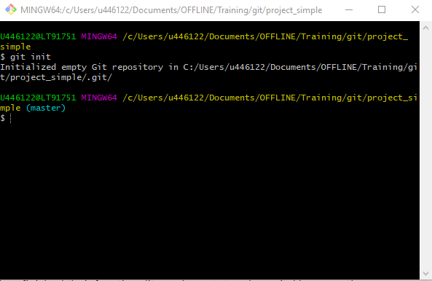
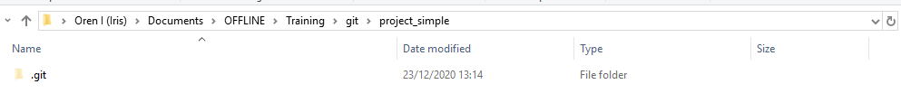
2. Simple Git workflow
Create folder in windows explorer called “project_simple” (preferably on C, as this will speed up performance)
“project_simple” will be the repo.
Need to initialise it. Right click, and choose “Git Bash here” (it might take a few seconds to open the bash terminal)
Type “git init”
This should create a .git folder in “project_simple”. The .git folder will contain the project history information that Git uses.

Slide 7

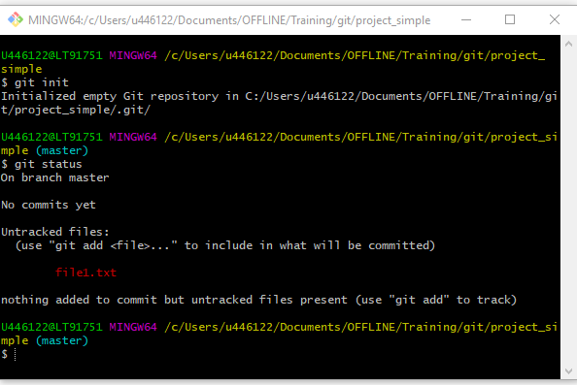
2. Simple Git workflow
https://buddy.works/blog/5-types-of-git-workflows
Tracking sequential changes
Add a file to project_simple: in windows explorer, right click, New, Text Document. Name it file1.txt. Add some text to the file.
Does git know about the change? Type “git status”
It sees a change, but changes to file1.txt are not being “tracked”.
Changes need to be added to the staging area

Slide 8
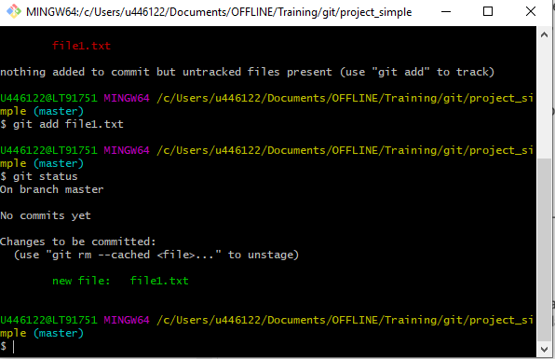
2. Simple Git workflow
Tracking sequential changes
Type “git add file1.txt” or “git add .” (the latter is used to add all changes to staging area).
Check the status
Files in the staging area, ready for commit are shown
All commits need a commit message. This can be added with “ –m `xxxxxx` “ appended to the commit command. Type “git commit –m `add file1.txt’ ”.
Check the status. You should have a clean working tree

Slide 9
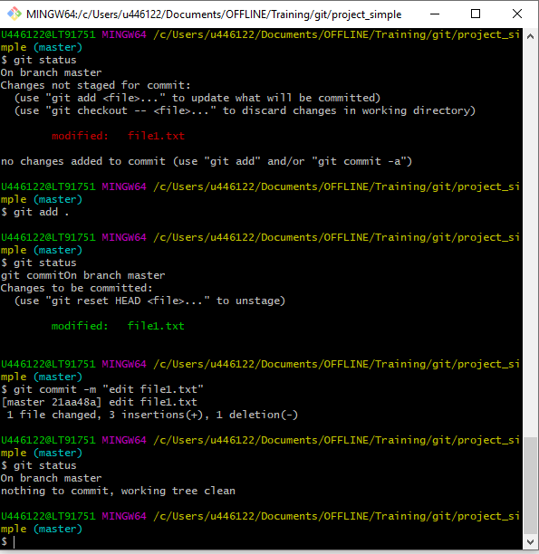
2. Simple Git workflow
Tracking sequential changes
Now change the text in file1.txt
Add the change to staging area and commit the change

Slide 10
3. Reverting to a previous commit
Project working directory
master
Commit 1
Commit 2
Commit 3
Initialise git repo

Slide 11
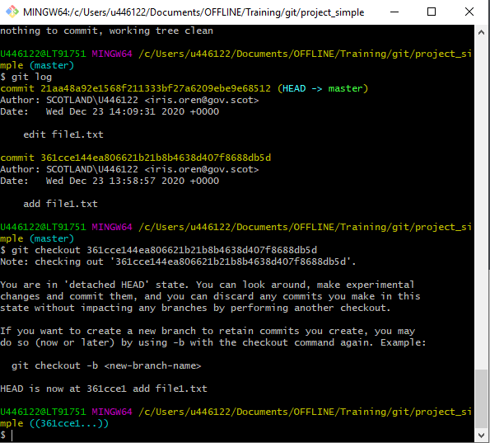
3. Reverting to previous commits
Each commit has a reference. To find out the reference, type “git log”
Moving between commits is called “checkout”
To checkout the previous version of the repo, type “git checkout <commit reference>” where the commit reference is the reference number of the commit of interest. Here, use your first commit.
Inspect file1.txt and confirm that the change has been reverted
For other ways to revert to previous versions, see https://www.systutorials.com/how-to-revert-changes-in-git/

Slide 12

4. Git branching and merging
Master is the ground truth
If we want to make changes without affecting master, we create a “branch” from a commit
Different features should be added in different branches
Branches can be created from branches
Branches are “merged” to combine changes (conflicts need to be resolved)
https://buddy.works/blog/5-types-of-git-workflows

Slide 13
4. Git branching & merging
master
git branch
Commit
Commit
git merge
branch_1

Slide 14
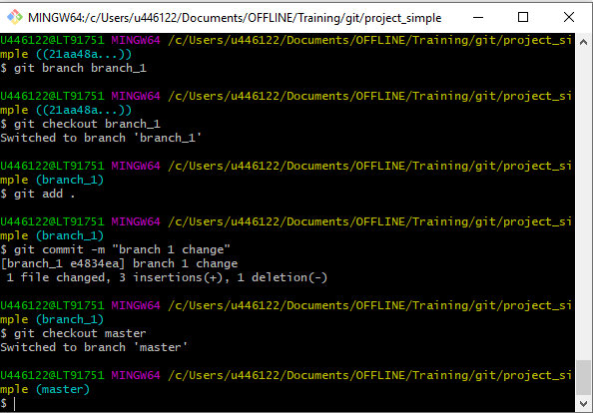
4. Git branching and merging
Checkout the latest change to project_simple
Now we will create a branch called “branch_1” and work on this branch.
“git branch branch_1”
Checkout the branch: “git checkout branch_1”
(The above commands can be combined with “git checkout –b branch_1”
Make changes to branch_1, add, and commit
Checkout Master to see that Master has not been affected. “git checkout master”

Slide 15
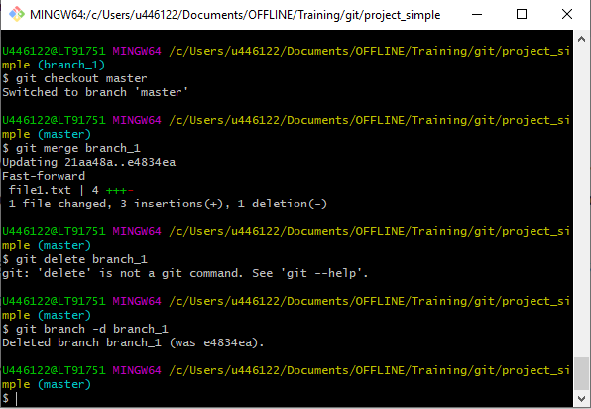
4. Git branching and merging
When ready to add the changes to master, we merge
First checkout master
To merge: “git merge branch_1”
After merging, you can delete the branch with
“git branch -d branch_1”

Slide 16
5. Git remotes
If collaborating, it is advantageous to have a master repo on a shared location, e.g. GitHub or a shared network drive.
This is the “remote” repo
Local copy of repo = “clone”
Local branches are “push”ed to the remote
Changes are “pull”ed from the remote

Slide 17
5. Git remotes
Origin =
Remote/master
Clone
Local/master

Slide 18
5. Git remotes
Origin =
Remote/master
Clone
Local/master
Local/master
Branch
Local/branch
Merge

Slide 19
5. Git remotes
Remote/branch
Origin =
Remote/master
Clone
Push
Local/master
Local/master
Branch
Local/branch
Merge

Slide 20
5. Git remotes
Remote/branch
Origin =
Remote/master
Remote/master
Clone
Push
Local/master
Local/master
Branch
Local/branch
Merge

Slide 21
5. Git remotes
Remote/branch
Origin =
Remote/master
Remote/master
Remote/master
Clone
Push
Pull
Local/master
Local/master
Local/master
Branch
Local/branch
Merge

Slide 22
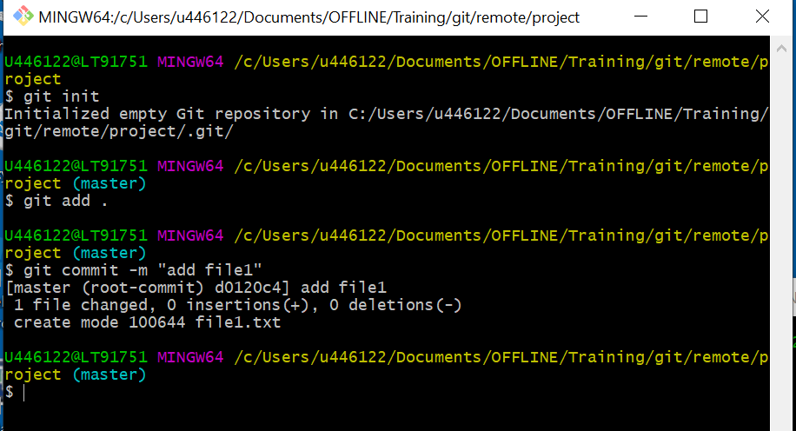
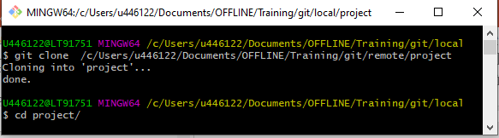
5. Git remotes
remote
Create a new folder with two subfolders “remote” and “local”
We will treat “remote” as the shared network location.
In remote/, create a folder called “project”, and initialise it as a git repo. Add file1.txt and commit the change.
We will need remote path information so highlight and copy the information in yellow at the git bash prompt
We will “clone” the remote repo to local. Navigate to local, open a “Git Bash Here”. Type “git clone <remote path>”
The remote repo is the “origin” (see next slide)
Change directory into the “project” subfolder by typing “cd project”
local

Slide 23
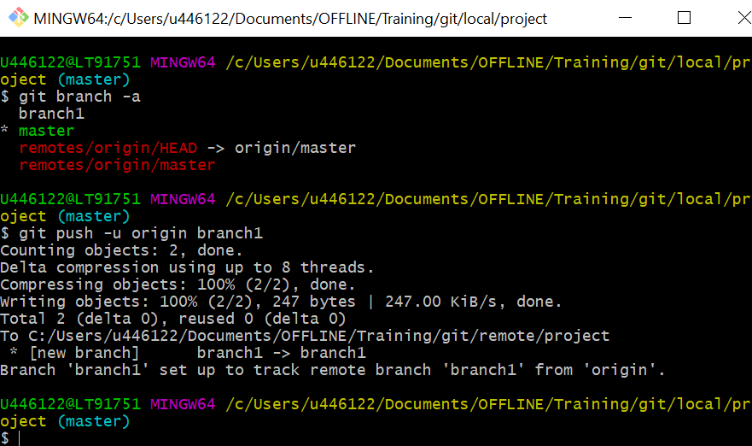
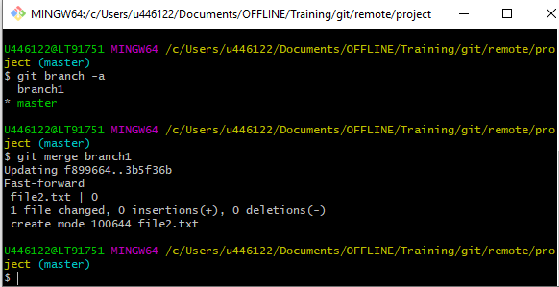
5. Git remotes
local
On the local clone, create a branch called “branch1” from master and commit a change then merge to local master.
Check the branches by typing “git branch -a”. This returns the branch information for local and remote repos.
The local branch can then be “push”ed to master. “git push -u origin branch1” (-u sets up the upstream tracking information, branch can be replaced with the name of your branch)
Get the branch information on the remote to confirm that the remote has the new branch
Merge the changes on the remote
remote

Slide 24
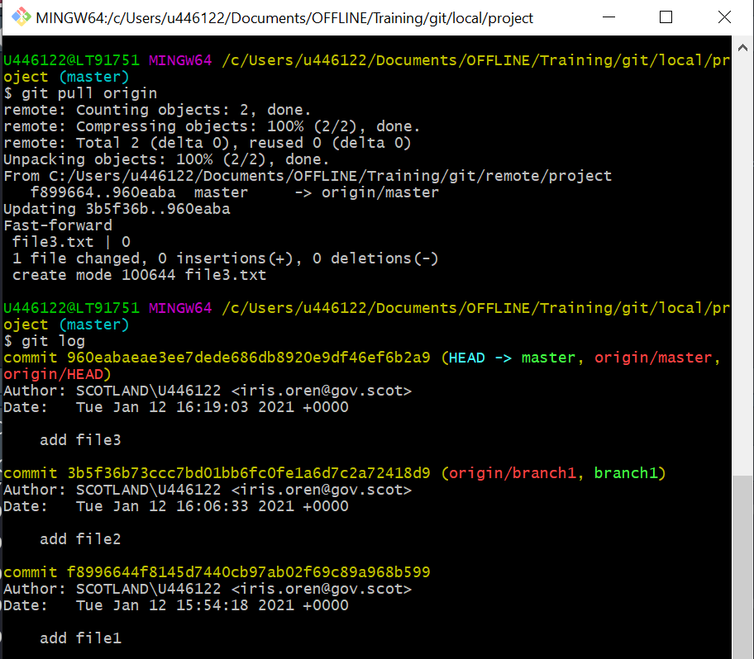
5. Git remotes
local
The next time you start working on local, you should get the latest version of the remote repo.
Git can either fetch the meta-info of the changes only (git fetch), or update local with the changes (git pull)
Here we will “pull” the changes.
Add file2.txt to remote/master and commit the change
In local, type “git pull origin”
Confirm the update on local by looking at the log
If you will work on branch1 again, you should rebase the branch (see “Tips”)
Learn about resolving merge conflicts (see “Resources”)

Slide 25
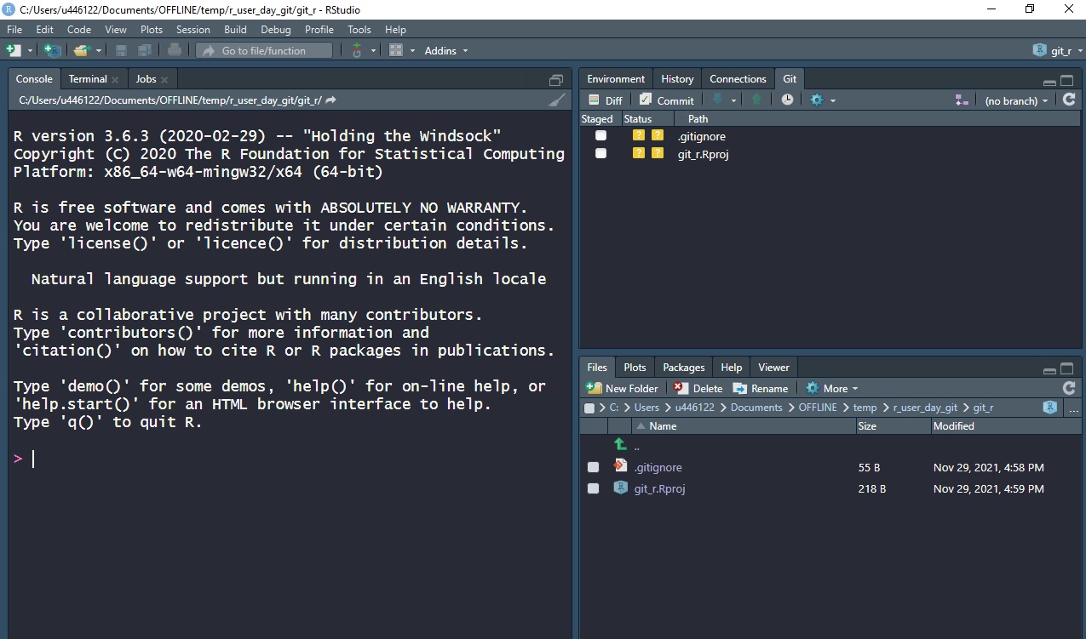
6. Git through RStudio
Using working directory in git repo adds Git tab
Good to have project directory as repo directory
Use a .gitignore to ignore R project file changes

Slide 26
6. Git through RStudio
Initialise git repo
Add + commit .gitignore
Initialise RProject
Add + commit project
Continue with workflow through Rstudio

Slide 27
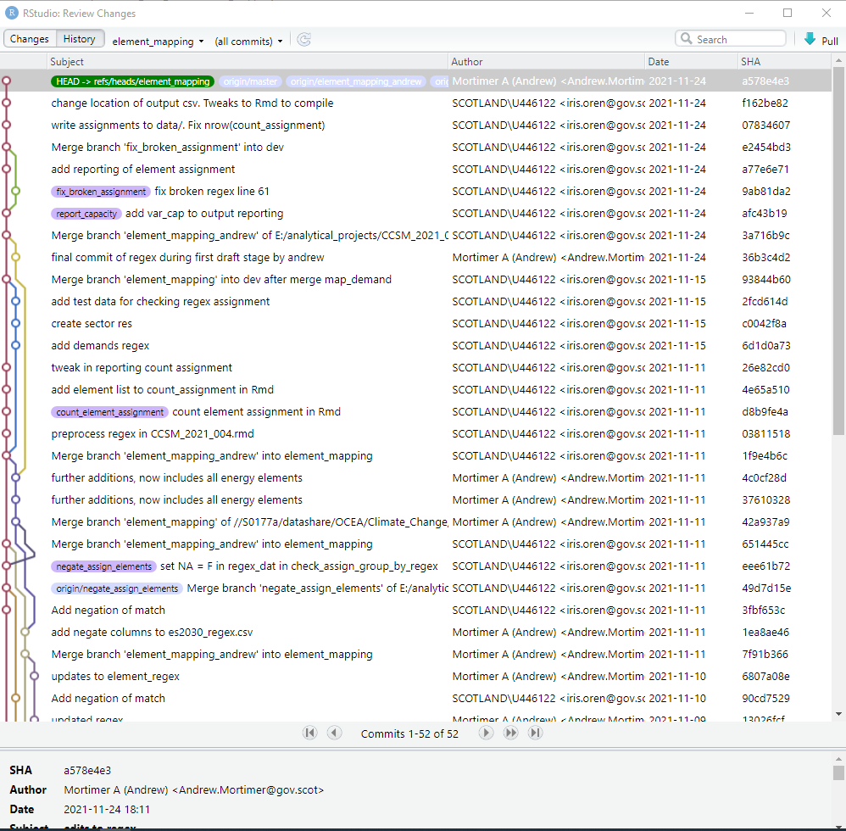
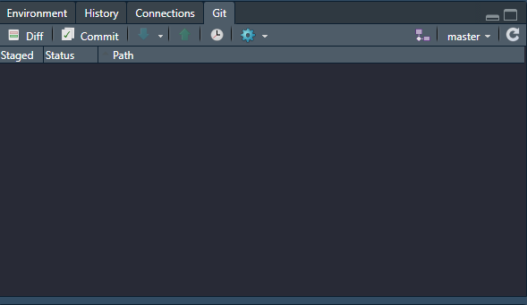
6. Git through RStudio
View repo history

Slide 28
7. Command reference & tips
What | command
Initialise a repo | git init
Check the status of the repo | git status
Add a file to staging area | git add . git add filename (wildcards * accepted)
Remove an added file from staging area | git reset filename
Commit to repo | git commit -m “message”
Find a commit reference | git log
Checkout a previous commit | git checkout commit_reference_num
Create a branch | git branch branchname
Checkout a previously created branch | git checkout branchname
Create and checkout a branch | git checkout -b branchname
Merge a branch | git merge branchname (after checkout of parent branch)
Delete a branch | git branch -d branchname
Clone a remote repository | git clone remote address or path
Push a branch to a remote | git push -u origin branchname
Push master to a remote | git push –u origin master
Integrate latest version of remote to your local repo | git pull origin

Slide 29
7. Command reference & tips
Tips
You can tell git to ignore particular files in the working directory by including a .gitignore file Gitignore Explained: What is Gitignore and How to Add it to Your Repo (freecodecamp.org)
Git is good for scripts. Big files make the repo heavy. Think about how to keep big files out of the repo.
Agree git workflow with team. Who is responsible for merges on remote?
git commands on network location are slow
Where do you want remote? GitHub (non-sensitive) or network location (sensitive)
Consider using a “bare repository” as your remote. Non-bare repositories only allow you to push branches, which you then need to merge on the remote. Bare repositories allow pushing master, however, the directory structure on the remote is not easily interpreted (but will be on your local). See Bare Repositories in Git – GeeksforGeeks
Learn about rebasing branches after a pull: Merging vs. Rebasing | Atlassian Git Tutorial

Slide 30
7. Command reference & tips
Other useful commands
What | command
Put on hold changes in a branch without committing | git stash
Readjust the base of a branch to the latest version of master | git rebase master (after pulling the latest master and checking out branch)
Compare branches | git diff branchname1..branchname2
Compare a single file between current version and last commit | git diff filename
Get the branch diagram | git log --all --decorate --oneline --graph
Escape from the editor that is instantiated by some git commands without saving | Esc :q!
Escape from the editor that is instantiated by some git commands with saving | Esc :wq
Switch to insert text mode in the editor that is instantiated by some git commands | i
Get the metadata for latest version of remote without integrating them | git fetch origin
Terminate any process | Ctrl-C

Slide 31
8. Resources
Git - user-manual Documentation (git-scm.com)
Help for any git command from the terminal “git help <command>”
Good tutorials: What is version control | Atlassian Git Tutorial
Git branches and workflows
Understanding merge conflicts: Git merge conflicts | Atlassian Git Tutorial
Cheat sheet: git-cheat-sheet-education (github.com)
SG RAP Yammer.
In the pipeline: SG Git guidance

